Slide 1
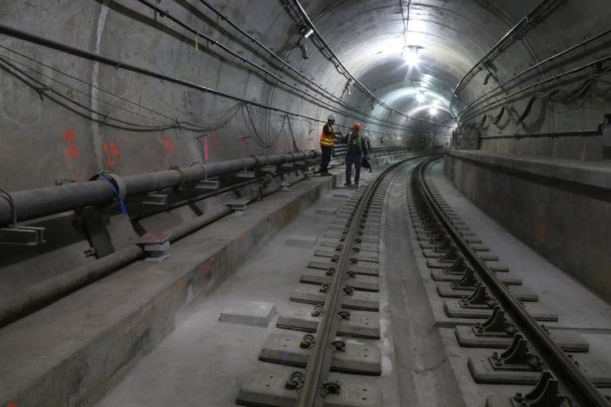
Second Avenue Subway:
Housing and transit
Team 10: Christian Moscardi, Sarah Schoengold, Hao Xi

Slide 2
Mad Men: “The Flood”

Slide 3
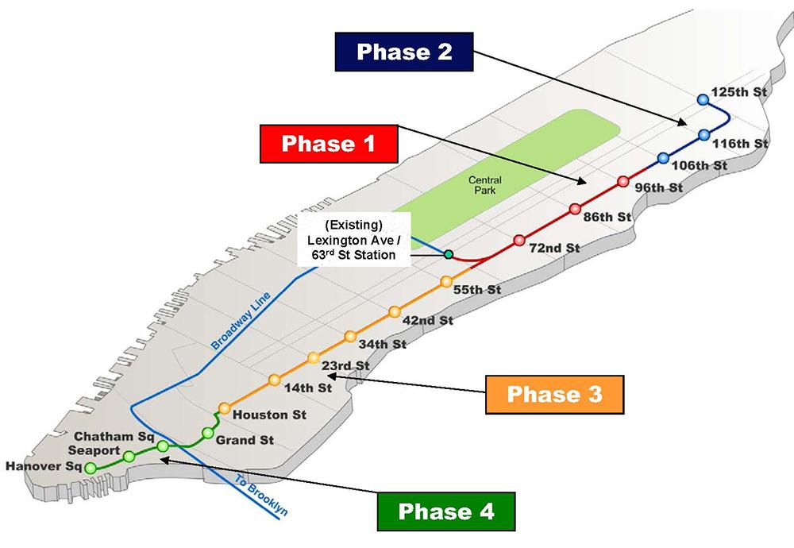
Problem statement
There are known relationships between proximity to public transportation and housing prices in urban areas. The Second Ave Subway (SAS) opened in January 2017 after nearly 100 years of fits and starts. By using a novel spatial model used to analyze similar developments, we want to understand if these established patterns hold true for SAS given its unique history and location within NYC.
Key questions include:
To what extent did anticipated improvements around this long-running project increase property values before the substantive effect of new transit took hold?
On what timescale did these value changes take hold?
Did expected trends hold 9 months after opening?
Image: http://www.remappingdebate.org/plan-full-blown-second-avenue-subway

Slide 4
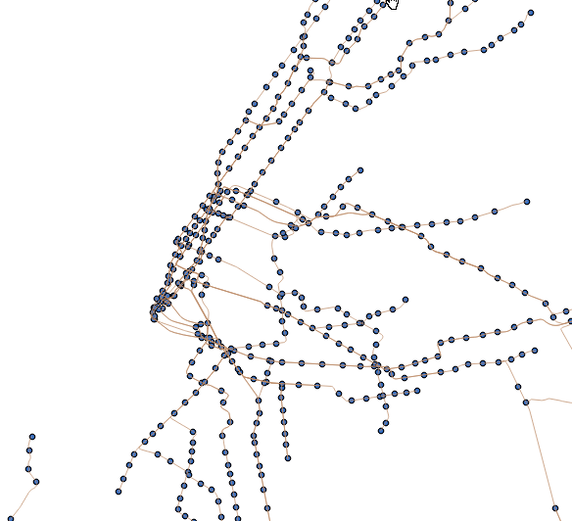
Data
Rental prices: StreetEasy web scrape using HTML parser
NYC Open data resources: PLUTO/ACRIS/NOPV/Recent Sales
Subway stop shapefiles
Demographic data (Census, ACS, etc.)

Slide 5
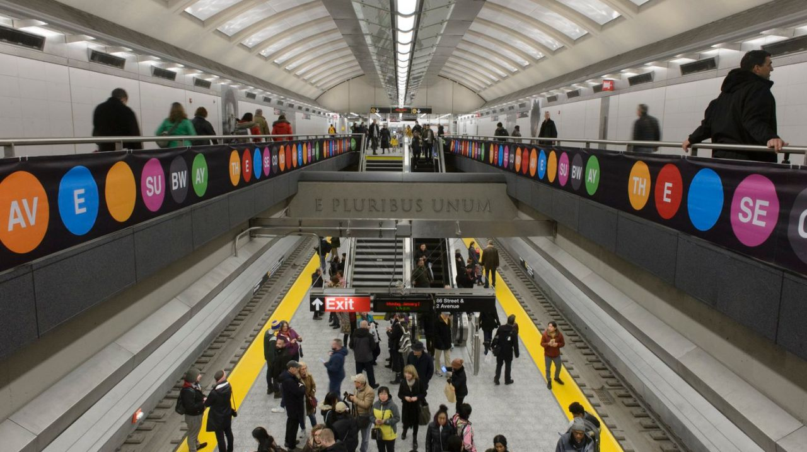
Research methods
Slice 2012-2017 based on key points in the SAS project timeline
Use a Spatial Difference-in-Difference model

Slide 6
Q&A?

